Slide 1
SAMPLING
MPA 630: Data Science for Public Management
November 1, 2018
Fill out your reading report on Learning Suite

Slide 2
PLAN FOR TODAY
Exam 2
Sampling vocabulary
Sampling in real life
Sampling with computers

Slide 3
EXAM 2

Slide 4
SAMPLING VOCABULARY

Slide 5
DEFINING THE POPULATION
Population
A collection of things in the world
Population parameter
Something we want to know about the population

Slide 6
COUNTING THE POPULATION
Census
Count every single thing in the whole population
Sampling
Select parts of the population and count those

Slide 7
MEASURE THE SAMPLE
Sample statistic or point estimate
The population parameter, but for the sample
Uses the hat sign; p-hat

Slide 8
IS THE SAMPLE GOOD?
Representativeness
Does the sample look like the population?
Bias and randomness
Does every part of the population have the same chance of being sampled?
Generalizability
Is p-hat a good guess of p?

Slide 9
WHY EVEN DO THIS?
Censuses are expensive and often impossible
If a sample is taken at random…
…it will be unbiased and representative…
…and the sample estimates can generalize to the whole population (within a confidence interval)

Slide 10
WHAT IF *YOU* AREN’T COUNTED?
Sampling gets us accurate estimates of population parameter—even if samples seem small!
Statistical power

Slide 11
SAMPLING IN REAL LIFE

Slide 12
M&M SAMPLING
What thing are we counting?
Define the population
What parameter are we measuring?
Count the population
Census or sample?
Measure the sample
What is our p-hat?
Is the sample representative?
Is the sample good?
Is the sample biased?
Is p-hat a good guess?

Slide 13
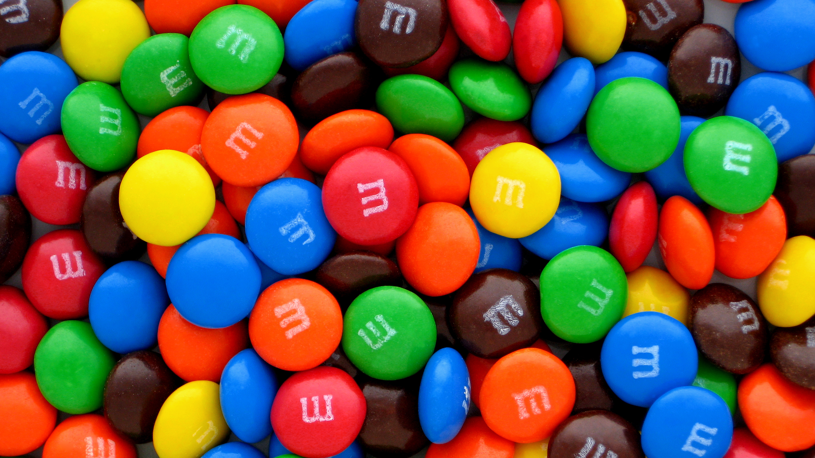
Notes:
https://commons.wikimedia.org/wiki/File:Plain-M%26Ms-Pile.jpg

Slide 14
THE TRUE P
Plant | City | Blue | Brown | Green | Orange | Red | Yellow
CLV | Cleveland, OH | 20.7% | 12.4% | 19.8% | 20.5% | 13.1% | 13.5%
HKP | Hackettstown, NJ | 25.0% | 12.5% | 12.5% | 25.0% | 12.5% | 12.5%
“Our color blends were selected by conducting consumer preference tests, which indicate the assortment of colors that pleased the greatest number of people and created the most attractive overall effect.”
“Each large production batch is blended to those ratios and mixed thoroughly. However, since the individual packages are filled by weight on high-speed equipment, and not by count, it is possible to have an unusual color distribution”
Notes:
https://blogs.sas.com/content/iml/2017/02/20/proportion-of-colors-mandms.html
https://qz.com/918008/the-color-distribution-of-mms-as-determined-by-a-phd-in-statistics/

Slide 15
IMPROVING P
What can we do to get a better estimate of the whole population of M&Ms?
More samples?
Bigger samples?
Bigger sample size = better sampling

Slide 16
SAMPLING WITH COMPUTERS

